Slide 1



BRITISH AIRWAYS CUSTOMER REVIEW ANALYSIS
Data Insights and Recommendations

Slide 2


TABLE OF CONTENT
Introduction
Sentiment Distribution
Distribution of Ratings
WordCloud
Recommandations
Conclusion

Slide 3

INTRODUCTION
This presentation analyzes customer reviews of British Airways, uncovering key insights into passenger satisfaction. Through data visualization and sentiment analysis, we identify recurring issues, notable strengths, and actionable recommendations to enhance the overall customer experience.

Slide 4
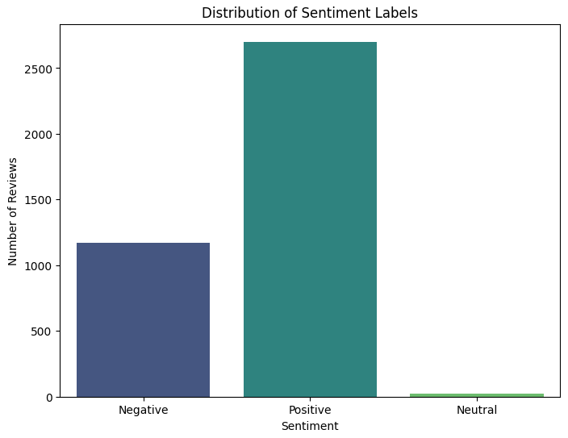

Sentiment Distribution
Positive : 2,701
Negative : 1,172
Neutral : 21
Positive Sentiment: 69% of reviews are classified as Positive.

Slide 5
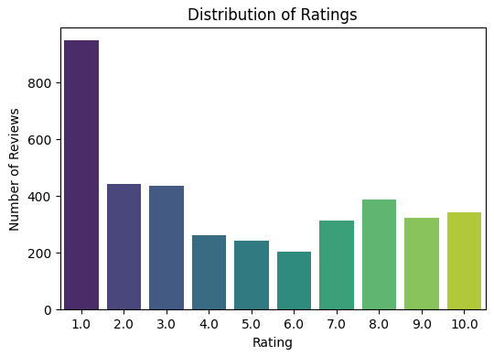
Distribution of Ratings
High Negative Reviews (46.9%): Low ratings (1-3) dominate, highlighting recurring issues.
Notable Positive Feedback (26.9%): Some customers praise comfort and service.
Neutral Reviews (26.2%): Mixed experiences suggest room for improvement.
Recurring issues and strengths highlight opportunities for improvement

Slide 6


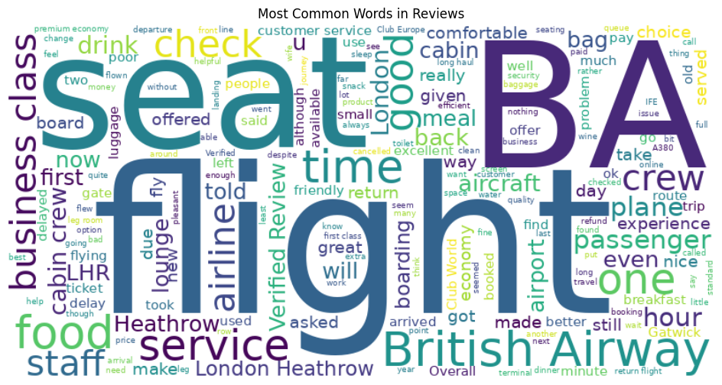
WORDCLOUD

Slide 7

Improve customer service training for staff.
RECOMMENDATIONS
Address delays and baggage handling issues.
Enhance communication with passengers during disruptions.

Slide 8

CONCLUSION
This analysis highlights critical areas for improvement while recognizing strengths, offering actionable steps to elevate British Airways' customer experience.

Slide 9




THANK YOU
+21-77-577-85-07
gabardiop1@outlook.com

